Slide 1
Infrastructure Automation with Terraform & Azure Devops on Azure cloud
Harshal Mittal

Slide 2
Setting up the Jump box environment. Section 4
Notes:
Let us learn about the required resources of jump box environment of our real life infrastructure scenario.

Slide 3
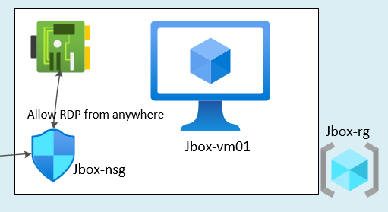
Jump box environment.
Jump box Environment Layout
Notes:
This is our jump box environment layout, which we are going to setup in our lab.
A resource group
A jbox virtual machine
A nsg for jump box and nic for the jumpbox.

Slide 4
Jump box resources
Jbox-rg (resource group)
Jbox-nic (Jump box network interface in the jbox-subnet)
Jbox-nsg (Network security group for Jumpbox)
Jbox-vm01 (Virtual Machine used as a Jumpbox)
Nsg rule to allow RDP from anywhere to the Jumpbox.
Notes:
In this Jump box environment I need to deploy following resources.
A resource group for Jbox environment.
A network interface for Jbox vm, which is going to be associated with Jbox-subnet which I have deployed as part of Frontend deployment.
A Network security group which is going to be used by jbox vm and associate this nsg to the jbox-nic.
Then I am going to deploy a Jbox vm and
allow rdp to jbox vm from anywhere.

Slide 5
Demo
Notes:
Let us setup the Jbox environment using terraform.

Slide 6
Reviewing the whole lab together.
Next video
Notes:
in next video we are going to Reviewing the whole lab together and I will setup the missing bits of the puzzle, like vnet peering, nat rules on the fw and allowing rdp on webserver from jump box only.

